Slide 1
Energy planning - strategic basis for business development in ODSHERRED MUNICIPALITY
By: Karina Jespersen climatework coordinator
Odsherred municipality

Slide 2
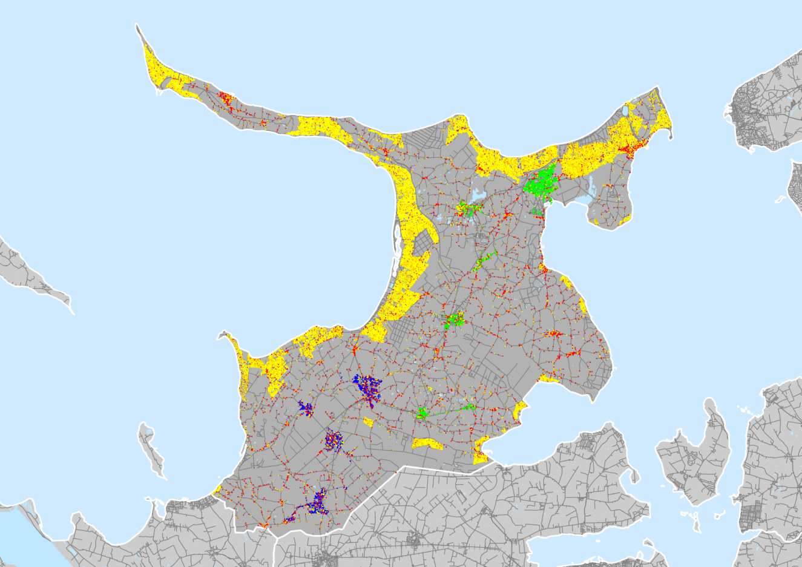
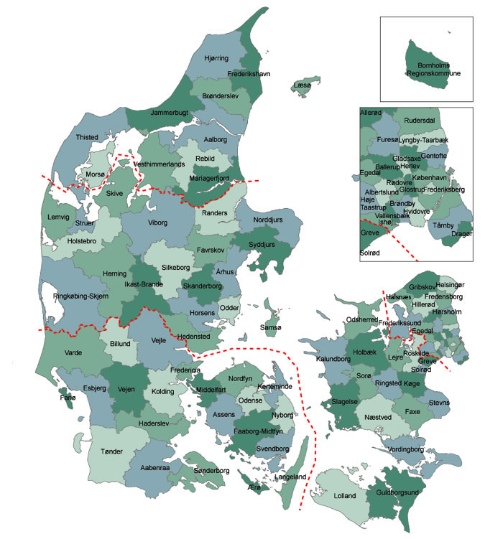
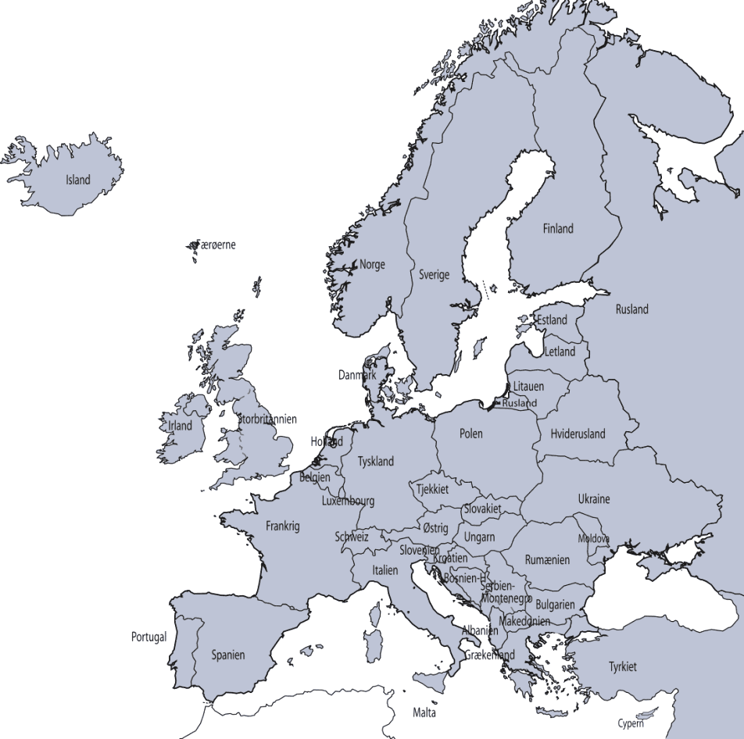

Slide 3
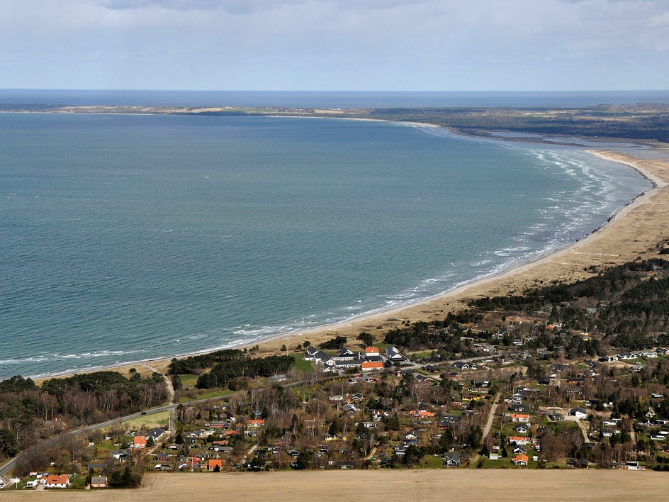
FACTS ABOUT ODSHERRED
Area is 355 km²
32.466 inhabitants 1. januar 2013
15.726 households 1. januar 2012
25.000 summer houses
12 villages and city areas
4 central heating plants
7 ”oil villages”
Mostly small and medium size companies

Slide 4
The objectives in the energy planning
Short terms goals –more than 20% CO₂ reduction before 2020. The goal is:
65.316 CO₂ eq
Long term goals – fossil fuel free electricity and heating production before 2035

Slide 5
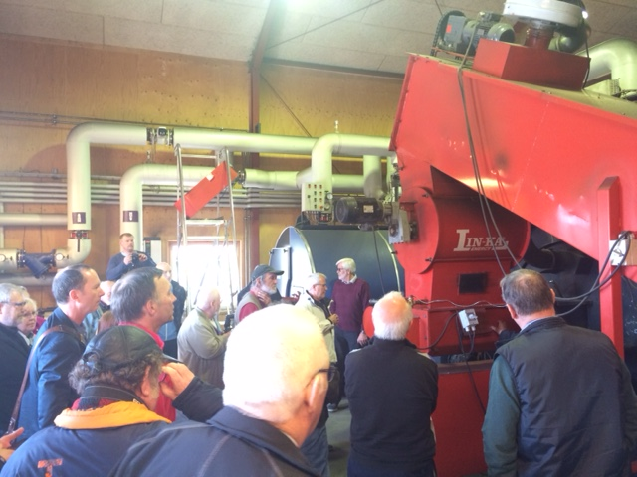
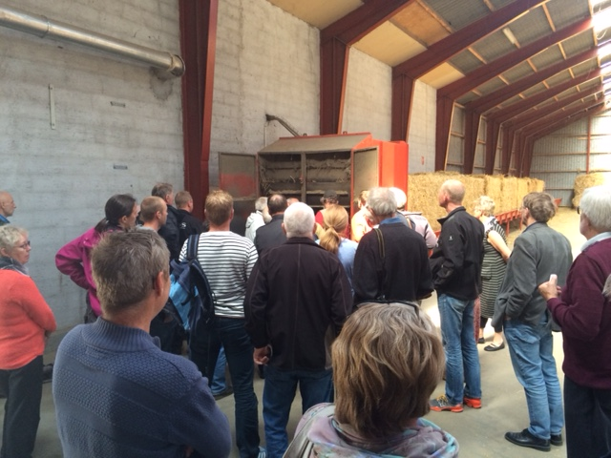
Strategic Focus in the energy plan
Company development(tourism, industry and argriculture)
Attracting and maintaining the amount of citizens ( by retain house values, improve the possibility of resale of houses, and creating stronger unity in the smaller towns)

Slide 6
Initiatives in the energy plan
Toward 2020:
Replacing existing windsmills potential unknown
Energy savings in houses and companies 8000 CO₂ eq
Symbiotic collaborations about reusing waste products between companies at least 2000 CO₂ eq
Small central heating plant in villages based on straw from local farmers 5.900 tons CO₂ eq
New central heating plant on biogas from local biomass ressources 24.000 tons CO₂ eq
Supplement the existing gas turbines on power plants with 1 MW engines based on local biomass 6000 – 14.000 CO₂ eq

Slide 7
Initiatives in the energy plan
Toward 2035:
Phasing out natural gas and replacing it with biogas etc
Intelligent management of energy systems
Increase the amount of windmills
Energy efficient argriculture
Private transportation

Slide 8
How does Odsherred succeed in its goals?
Using local biomass and ressources
Listening to what citizens and companies needs
Starts projects where there is local initiative among citizens and companies
Creating the ”good stories” and telling the story about the positive spin of effects again and again. Prices on heating and elctricity is crusial for companies and private households

Slide 9
How does odsherred succeed in its goals?
Working with local companies in the construction business to qualify their work with energy efficiency in households
In the ”energy check project” we have both an independent energy adviser, banks and architecs involved

Slide 10
Time for questions

Slide 11
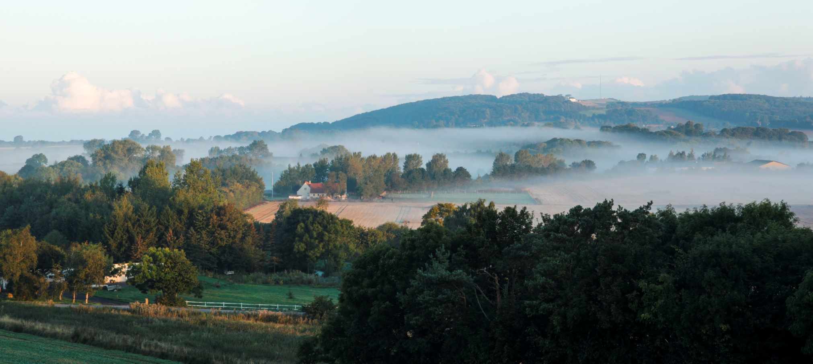
Thank you for the attention

